Slide 1
Growing complex network of citations of scientific papers: Modeling and measurements
Michael Golosovsky and Sorin Solomon

Slide 2
Introduction
Network of citations of scientific papers
A stochastic model of citation dynamics
Both for statistics of references of scientific papers and for their citation dynamics.
Most important finding: nonlinear citation dynamics
Quantitative probabilistic prediction of citation dynamics of individual papers and of the journal impact factor.

Slide 3
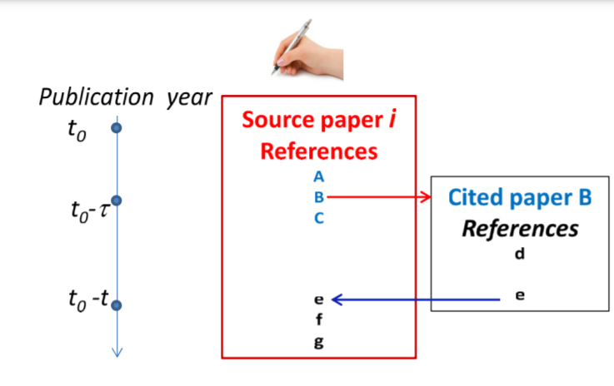
Cartoon Scenario of the Referencing Process

Slide 4
Recursive search algorithm
Assumptions about the author of a new scientific paper
Finds relevant papers from the media or journals and cites them.
Studies the reference lists of these preselected papers, picks up relevant papers, cites them as well, and continues this process recursively.
If some paper is cited by several preselected papers, the author chooses it with higher probability than those cited by only one preselected paper

Slide 5
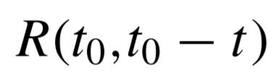
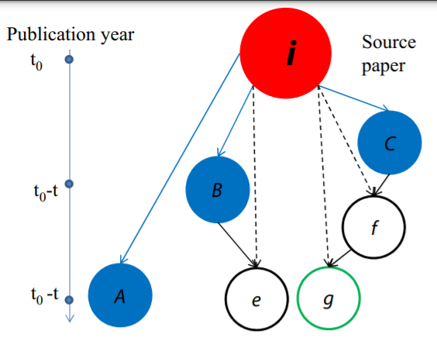
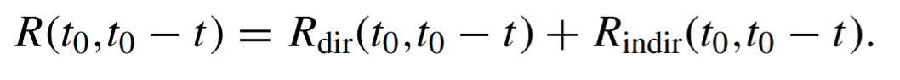
Recursive search algorithm
Direct and Indirect References
B
Average number of references in the reference list of these papers that were published in the year
Head of a cascade: direct reference.
Entails an indirect reference that can entail another indirect reference and so on

Slide 6
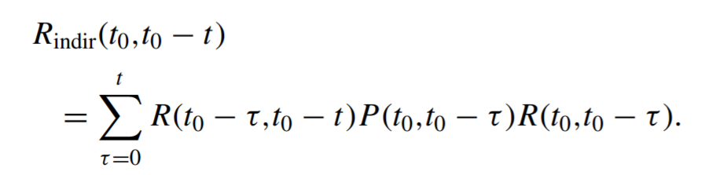
Recursive search algorithm
probability that the second-generation reference picked up from the first-generation reference that was published in the year is copied to the reference list of the source paper which was published in the year

Slide 7
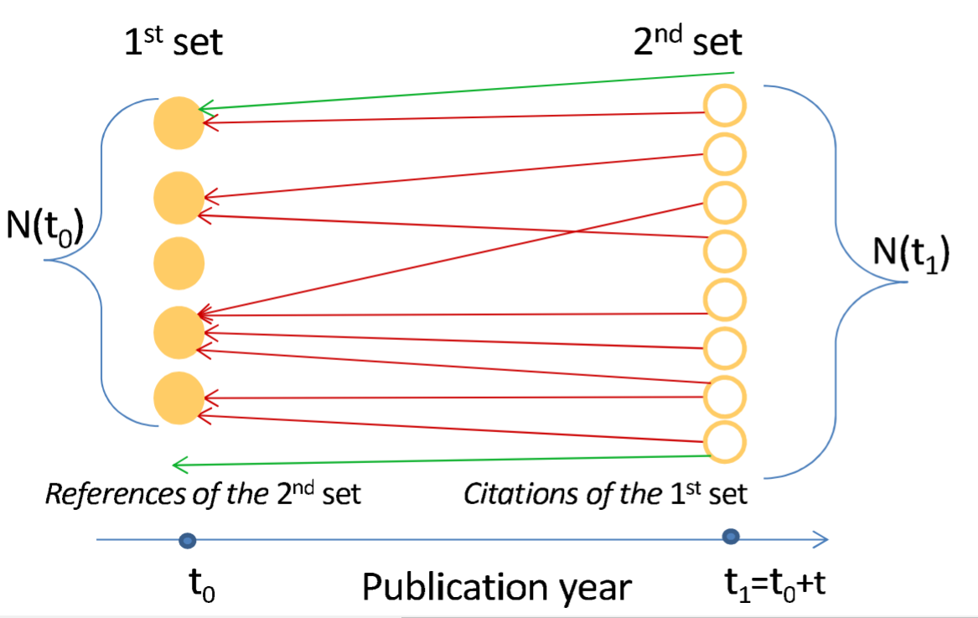
Reference-citation duality

Slide 8
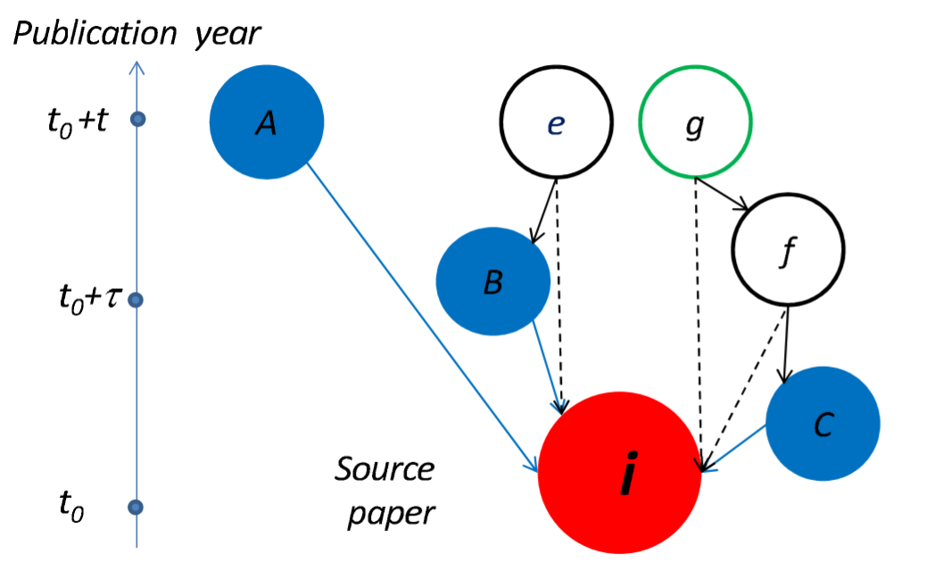
Model: Citation dynamics of individual papers
Reformulate scenario in terms of citations

Slide 9
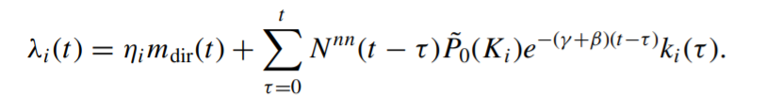
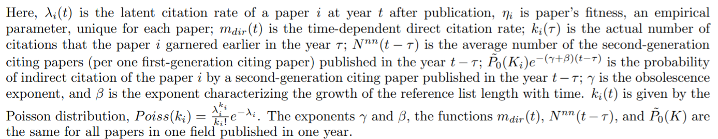
Key Result: Stochastic Model of Citation Dynamics
nonlinear stochastic dynamic equation：latent citation rate of a paper i at year t after publication

Slide 10
Key Result: Stochastic Model of Citation Dynamics
Model validation dimensions:
cumulative citation distributions
stochastic component of the citation dynamics
citation trajectories of individual papers
autocorrelation of citation trajectories
the number of uncited papers

Slide 11
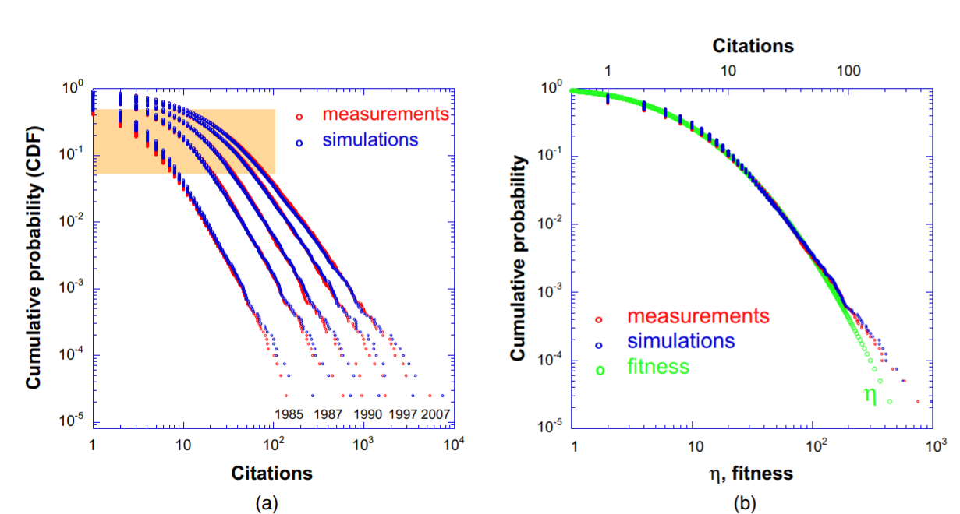
Key Result: Stochastic Model of Citation Dynamics
Cumulative citation distributions: 40 195 physics papers published in 1984
log-normal distribution

Slide 12
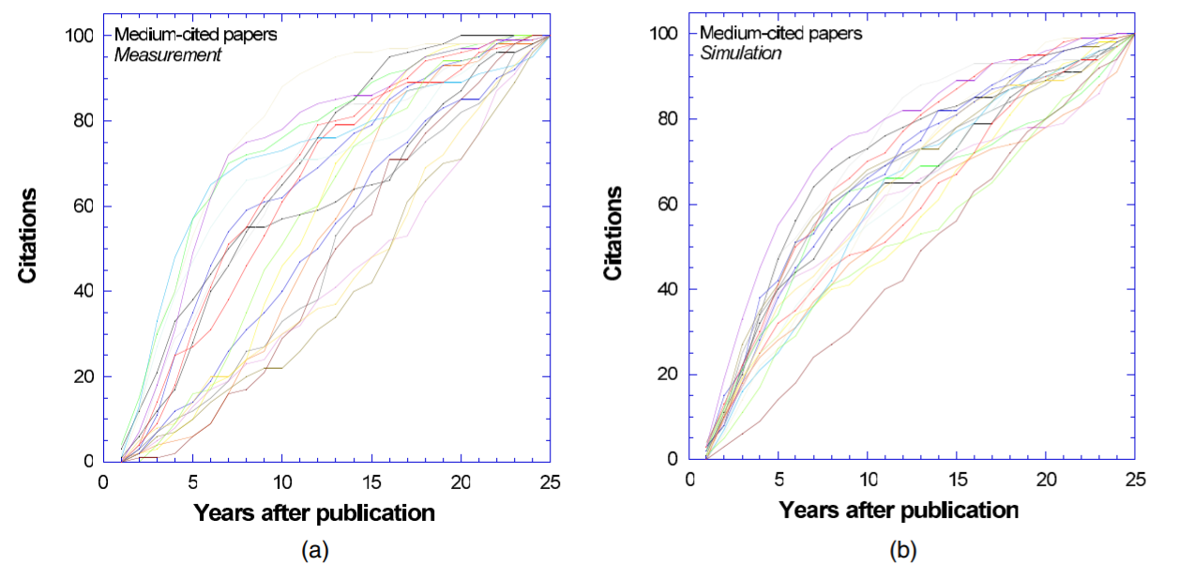
Key Result: Stochastic Model of Citation Dynamics
Citation trajectories of individual papers: published in 1984 and accrued 99 citations in subsequent 25 years, stochastic simulation for prediction

Slide 13
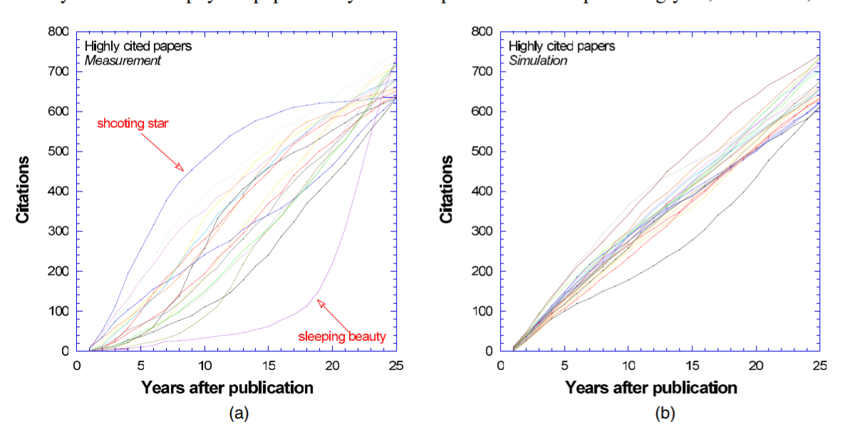
Key Result: Stochastic Model of Citation Dynamics
Citation trajectories of individual papers: published in 1984 and accrued 600–750 citations in subsequent 25 years

Slide 14
Conclusion
Similar citation dynamics for other fields: mathematics and economics papers
Lognormal fitness distributions
Recursive search algorithm: dynamic nonlinearity
The ideas advocated in highly cited papers undergo viral propagation in the scientific community, while the low-cited papers affect only a small part of it
Play an important role in viral propagation in social media
Extension to other networks: spreading of ideas, rumors, diseases, and viral marketing

Slide 15
Work Cited
Golosovsky M, Solomon S. Growing complex network of citations of scientific papers: Modeling and measurements. Phys Rev E. 2017 Jan;95(1-1):012324. doi: 10.1103/PhysRevE.95.012324. Epub 2017 Jan 30. PMID: 28208427.

